Slide 1

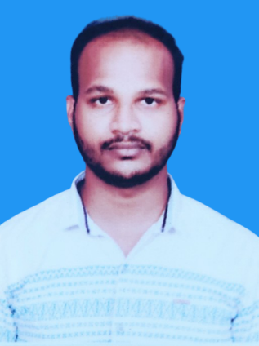



Korada Santhosh
Education and certificates
Bachelor of Technology In
Mechanical Engineering : 2017 - 2021
Skills
Analyst/Software Engineer
Base Location: Mumbai
React Framework
Database
Spring Boot
Spring MVC
Bootstrap
Node JS
Angular
Email ID: korada.santhosh@capgemini.com
_{Mobile No:} +91 9133528936
Grade: A4
Strengths
A self driven learner with Front-End and Back-End knowledge. Passionate about implementing and launching new projects.
Achivement
Online Corona Consultation System
Backend
Spring Boot
Spring MVC
REST-API
Database
Postgre SQL
My SQL
Completed end to end case study of Online corona consultation system with the help of Spring boot and Postgre SQl database. React framework used for user interface.
Ready to learn new technologies/frameworks and implement them to further improve my knowledge.
A team player with good communication skill always ready to work for the enrichment of knowledge.
Designed Static and Dynamic Web Pages
Developed website with HTML5 and CSS3 along with React framework to make website more interactive and colourful.
Web Technologies
HTML5
CSS 3
Javascript
Bootstrap
Has working knowledge on React and Java Microservice Development using Spring framework on an beginner level.
Certifications
AWS certified cloud practitioner
Agile Software Development
Add-ons
Maven
Postman
Additional Details
Communication Skills
Leadership quality
Have decent knowledge on Databases like SQL, My SQL and Postgre SQL
Check out my work on GitHub.
Presentation Title | Author | Date © Capgemini 2017. All rights reserved | 1

